Slide 1
EXZELLENZ
VERBINDET –
BE PART OF A
WORLDWIDE NETWORK
Speaker
Function
Date
Name of event

Slide 2
CONTENTS
What we do
Our roots
Our network
Sponsorship opportunities

Slide 3
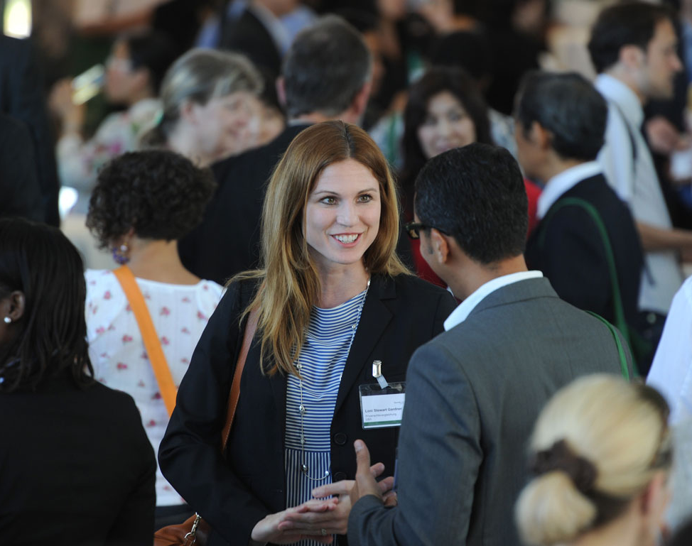
WHAT WE DO
  Academic collaborations between excellent international and German researchers
  Sponsorship throughout lifetime
  A network of 30,000 alumni worldwide
  International understanding, diplomacy, scientific progress and development
  Internationalization of Germany as a research location

Slide 4
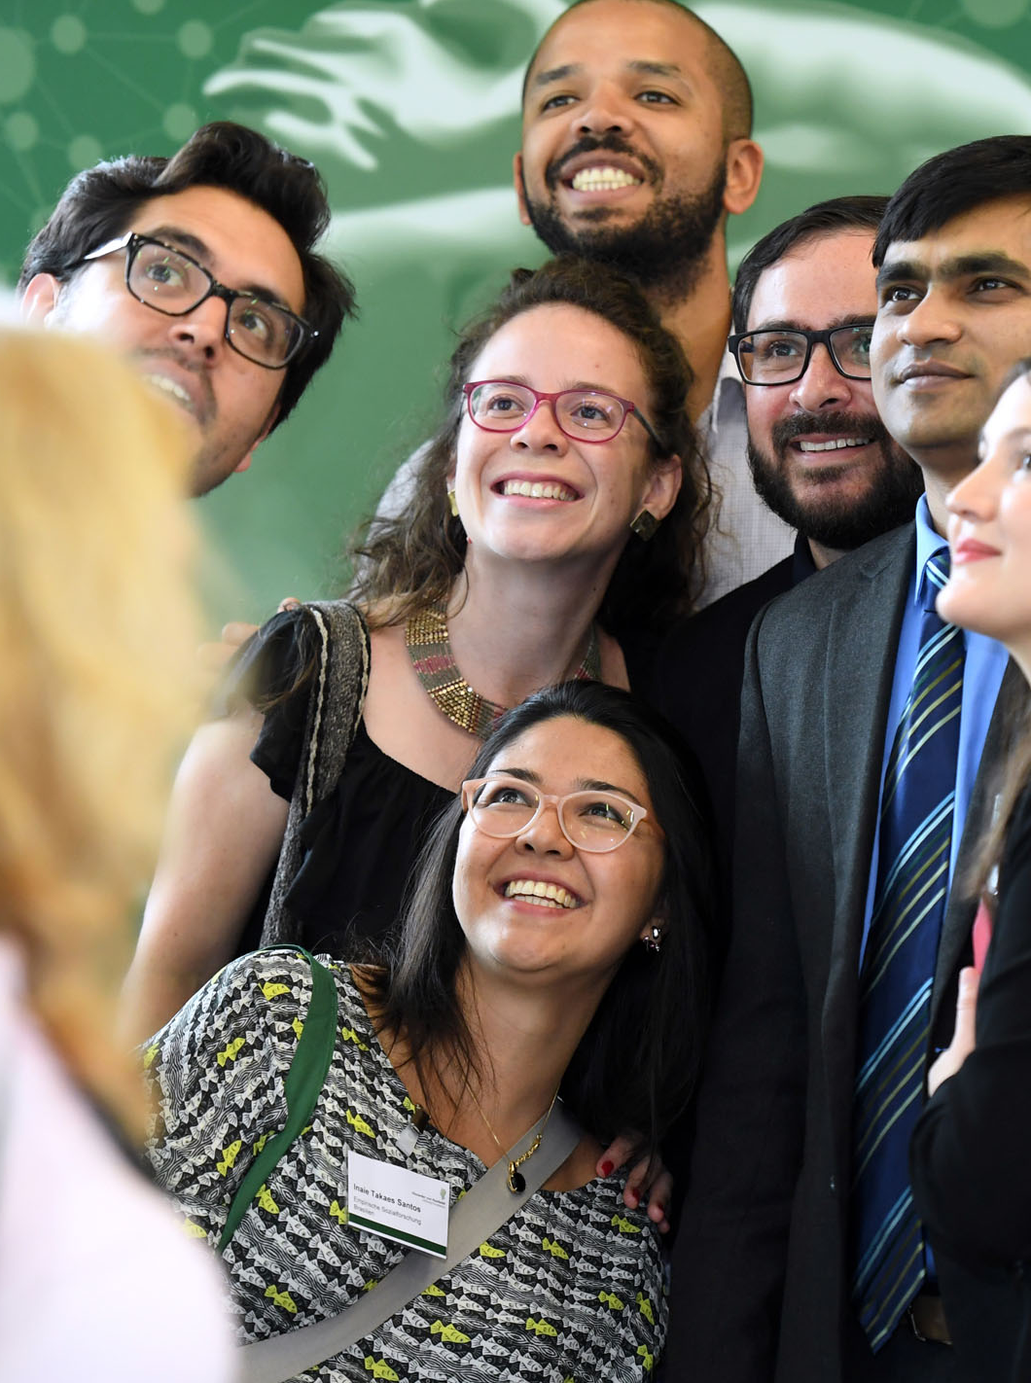
WHAT WE DO
    Research fellowships and research awards for researchers from abroad
    Chosen research project with a a host and collaborative partner in Germany
    Alexander von Humboldt Professorship: Germany’s most valuable research award
4 | 03.04.2023

Slide 5
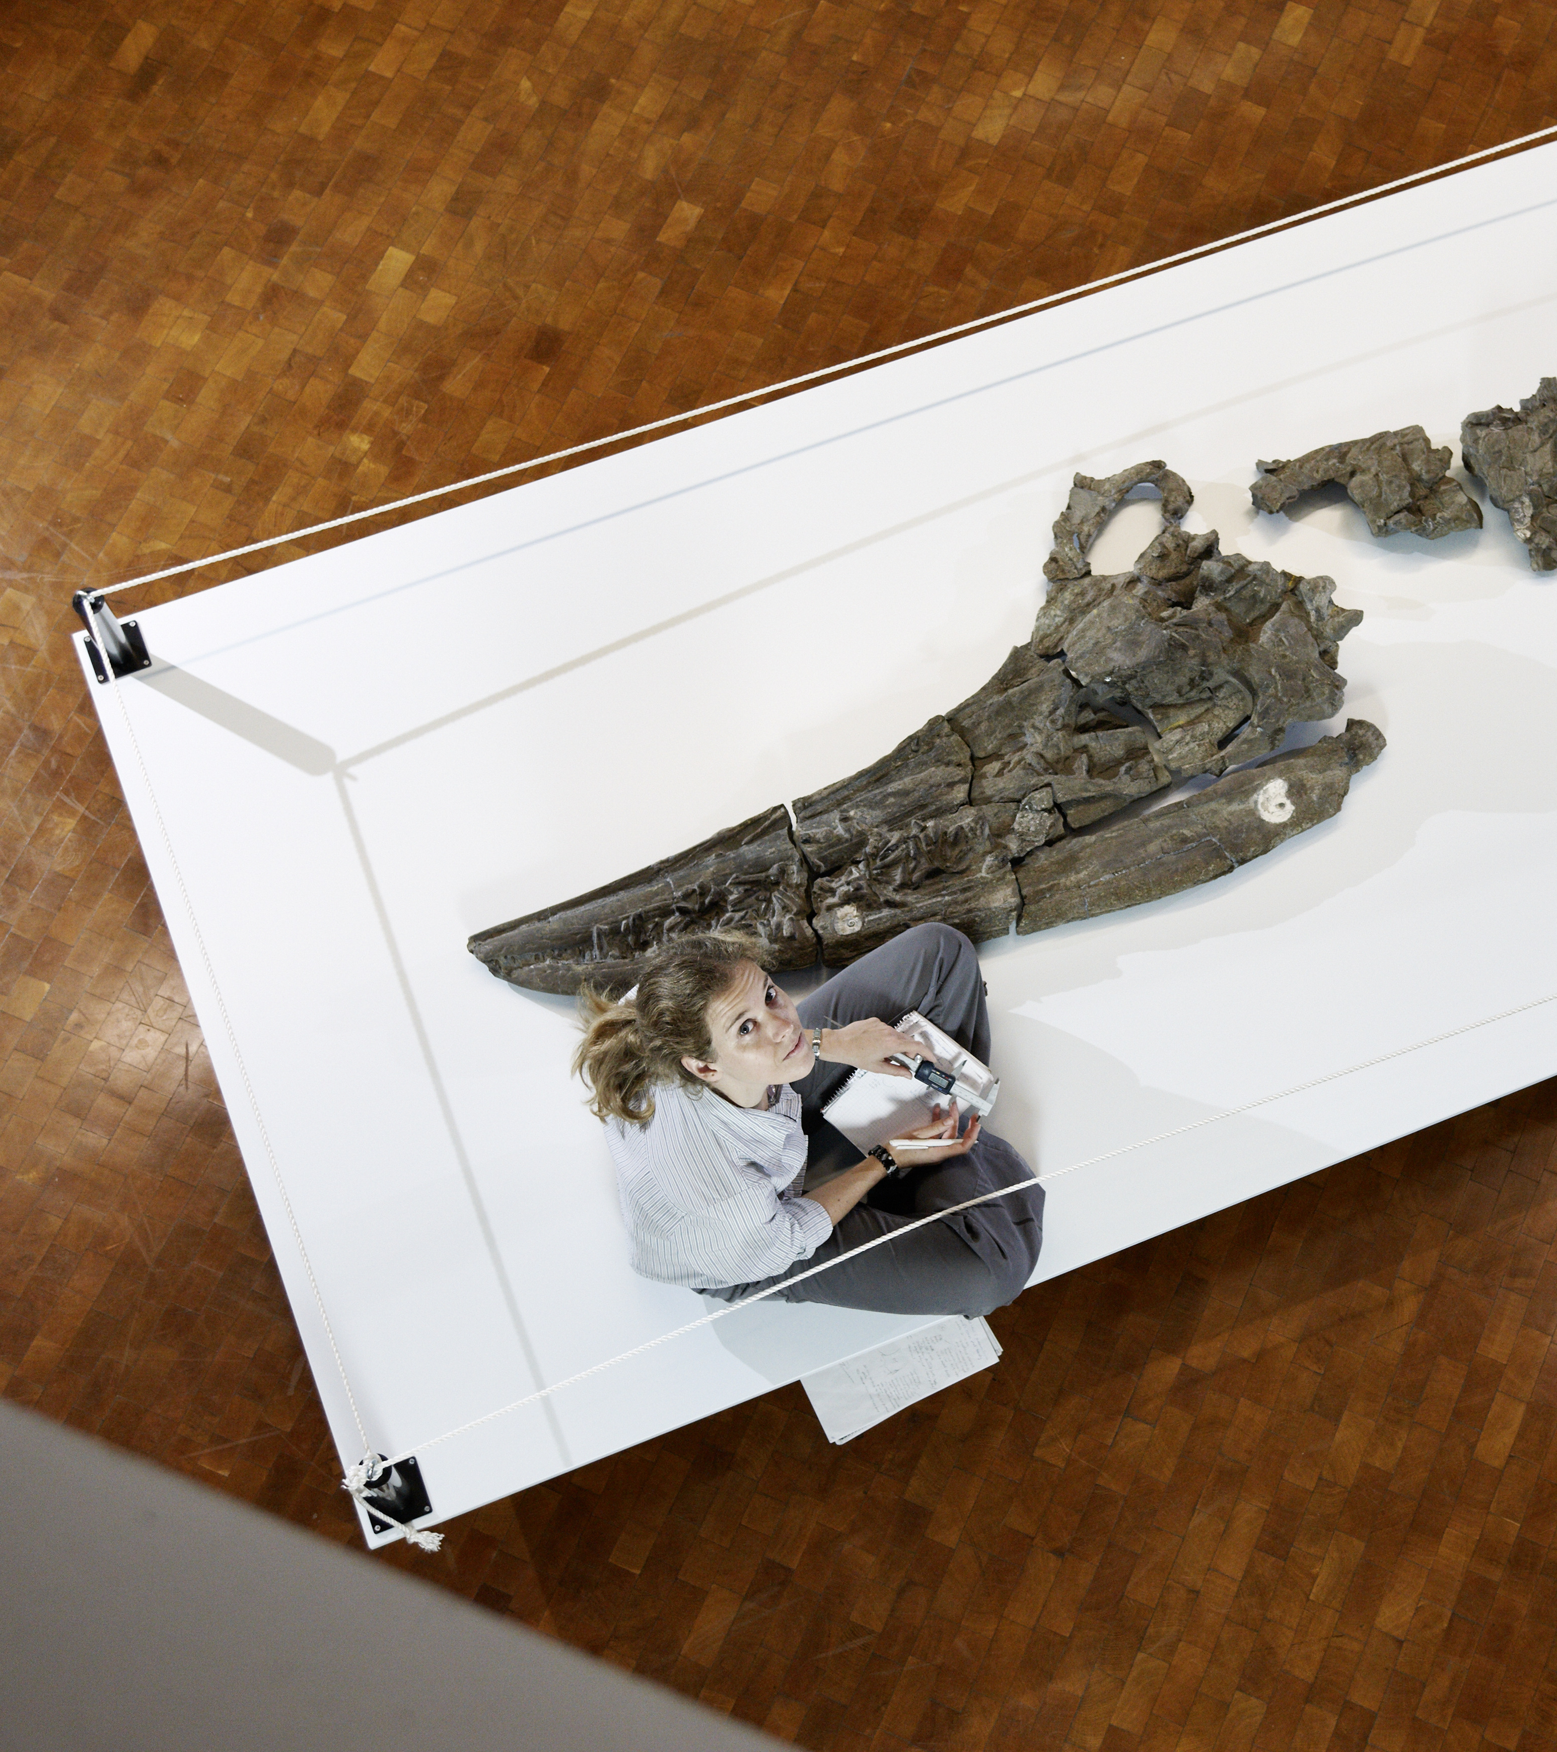

WHAT WE DO
    Research fellowships for researchers from Germany
    Research project as the guest of a member of the Humboldt network abroad

Slide 6
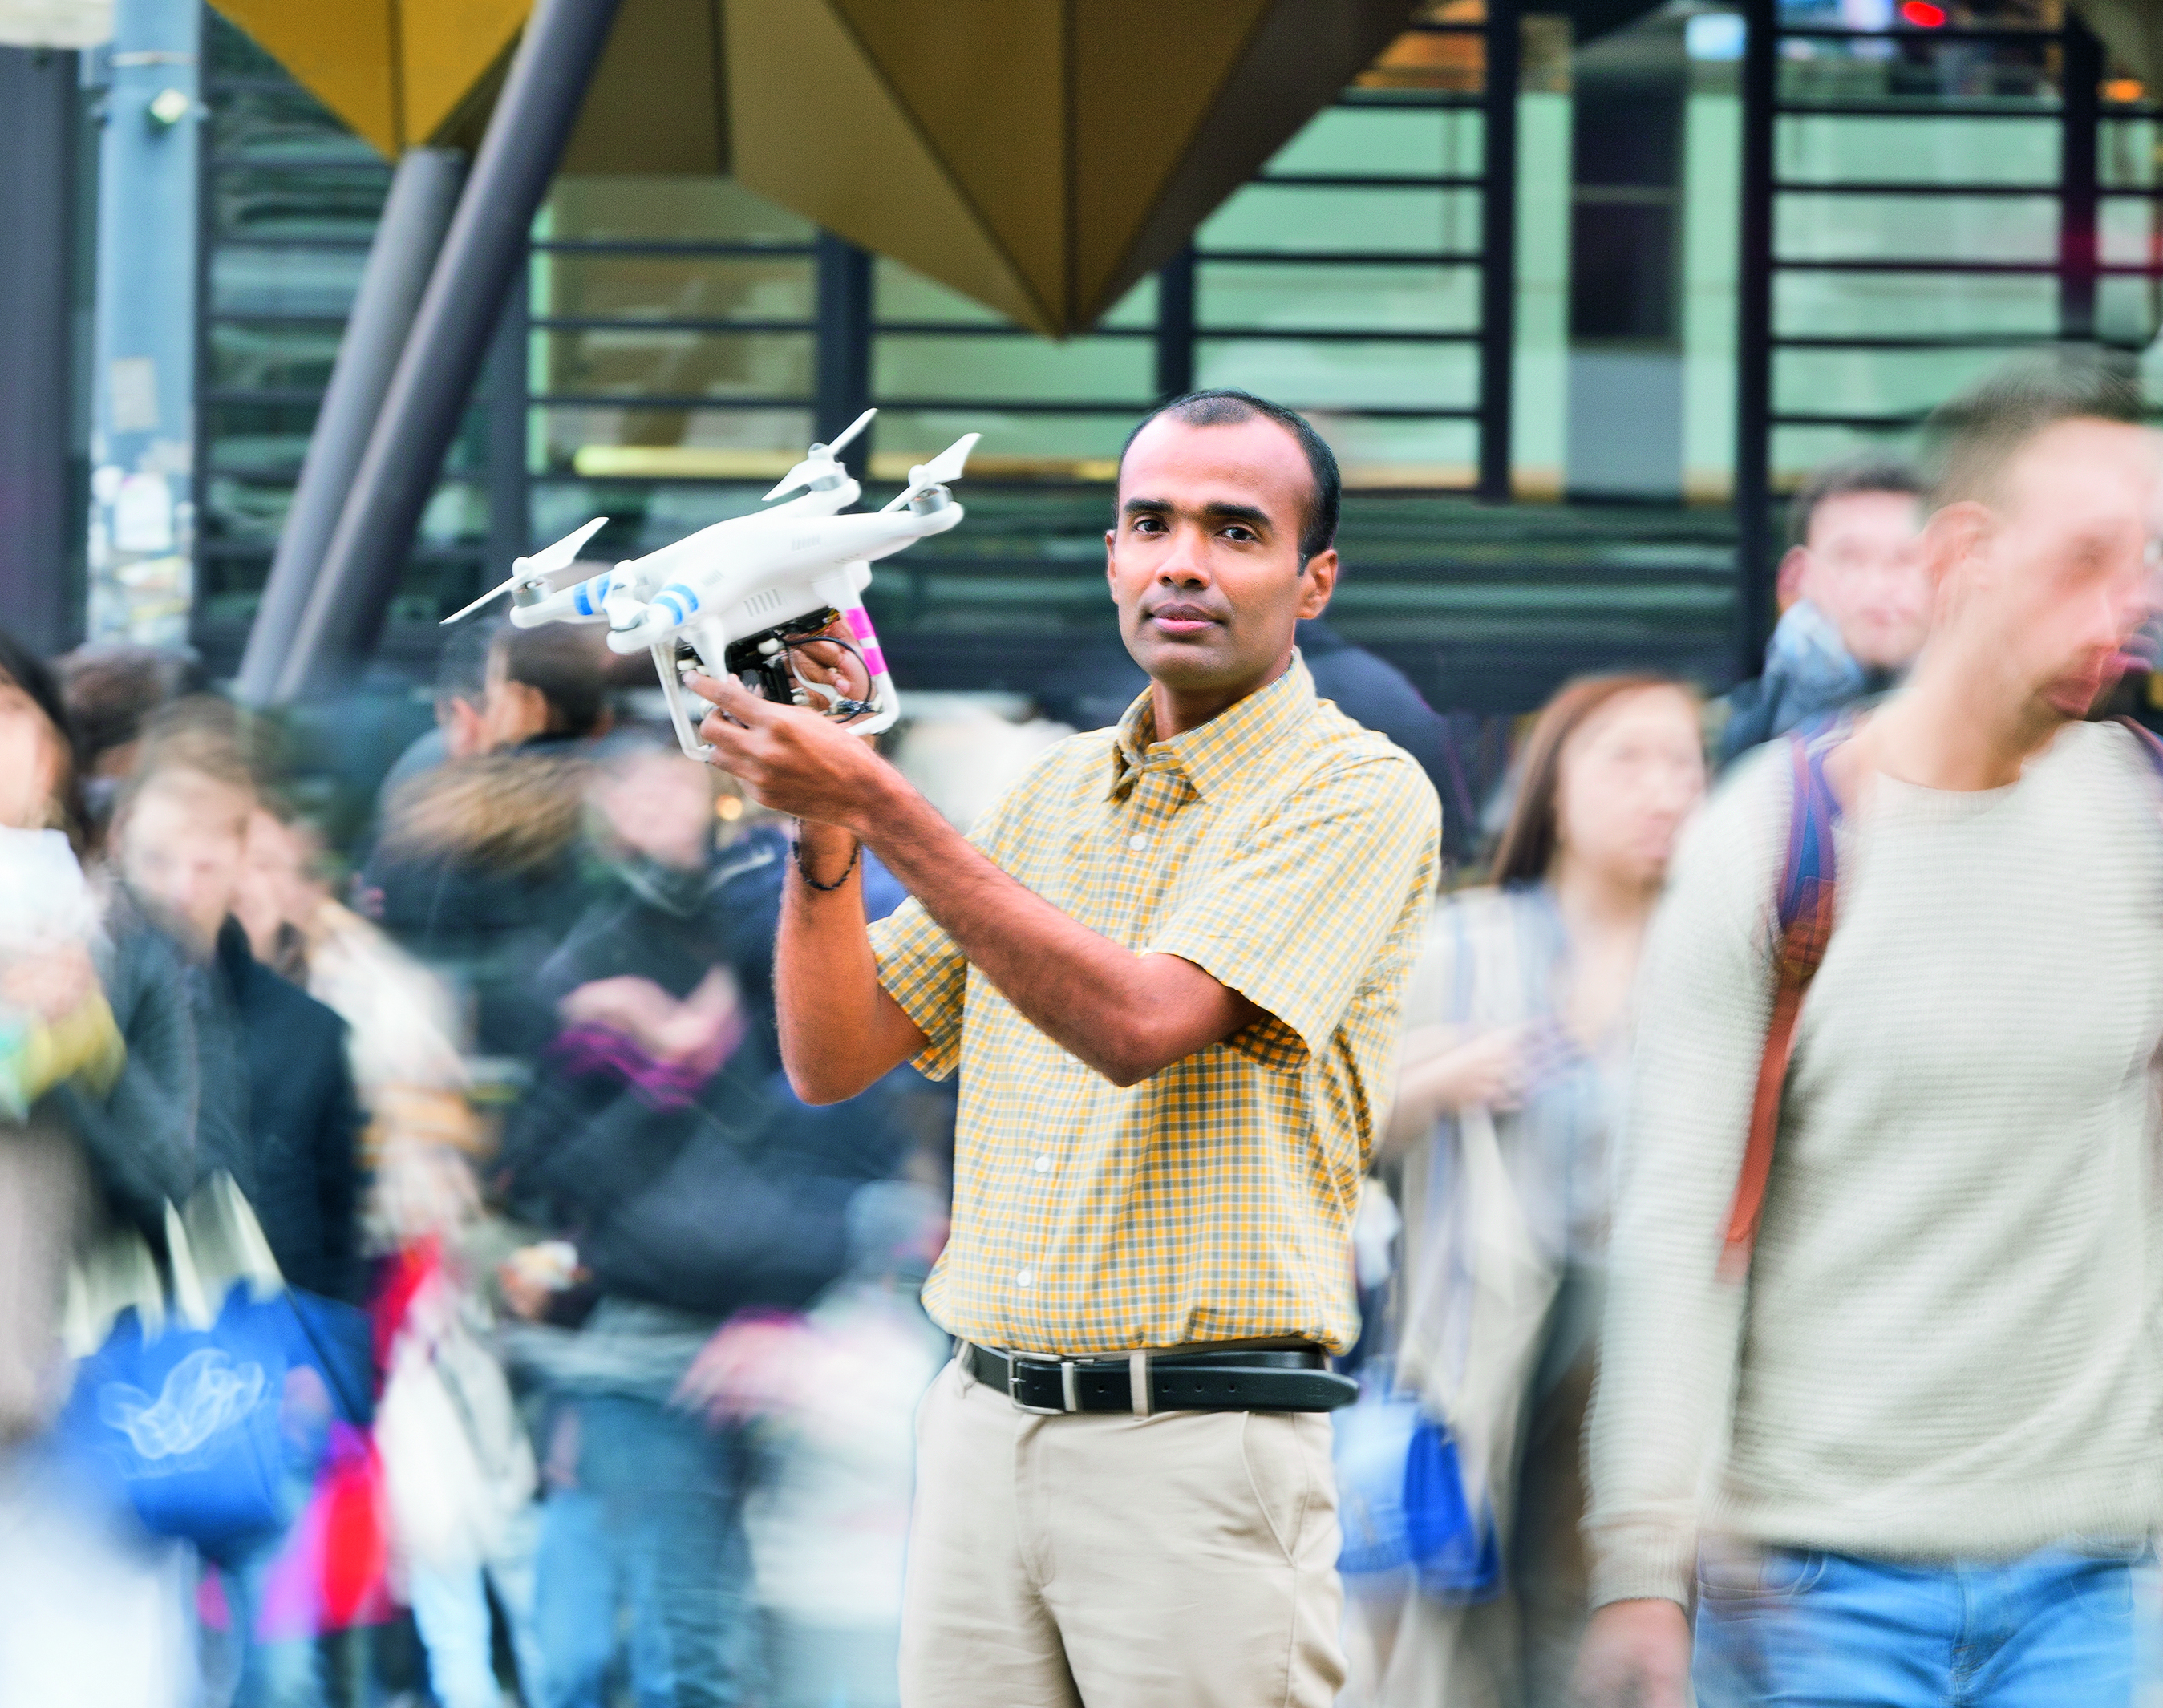
WHAT WE DO
    No quotas, neither for individual countries nor for specific academic disciplines
    The only thing that counts is the applicant’s academic record.
    We support people, not projects.

Slide 7
HUMBOLDT FOUNDATION FINANCING
Budget 2023*: approx. 163.3 mill. euros, 93 percent financed through federal funds
AA 36,1 %
BMZ 7,1 %
BMWK 1,5 %
EU 3,6 %
Others 3,0 %
BMBF 48,7 %
AA: Federal Foreign Office
BMBF: Federal Ministry of Education and Research
BMZ: Federal Ministry for Economic Cooperation and Development
BMWK: Federal Ministry for Economic Affairs and Climate Action
* according to the 2023 budget

Slide 8
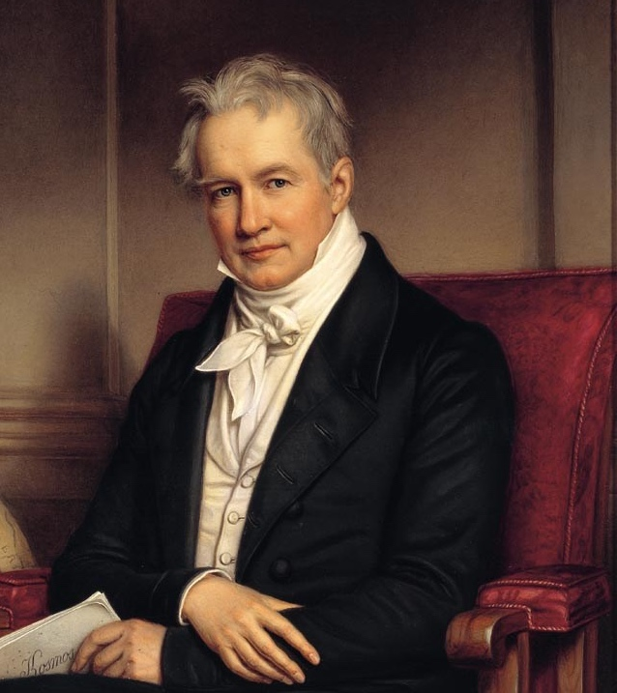
OUR ROOTS
Alexander von Humboldt (1769 – 1859):
explorer, universal genius, cosmopolitan and sponsor of excellent scientific talent
1953: Establishment of today’s Alexander von Humboldt Foundation, based in Bonn Bad-Godesberg
International network of academic cooperation, modelled on Humboldt

Slide 9

IDEAS CAN ONLY BEAR FRUIT
IF THEY TAKE ROOT IN MANY MINDS.
OUR NETWORK
„
Alexander von Humboldt
World-spanning Humboldt Network transcending the boundaries of disciplines and countries
Scientific solutions to the challenges of our times
A network of trust and understanding
9 | 03.04.2023

Slide 10
OUR NETWORK
950
Awards and fellowships every year
Alumni in more than
140
countries
2300
Research stays in Germany every year

Slide 11
30000
Humboldtians across the world
59
Nobel laureates
40
Conferences and meetings across the world every year
109
Humboldt alumni associations worldwide

Slide 12
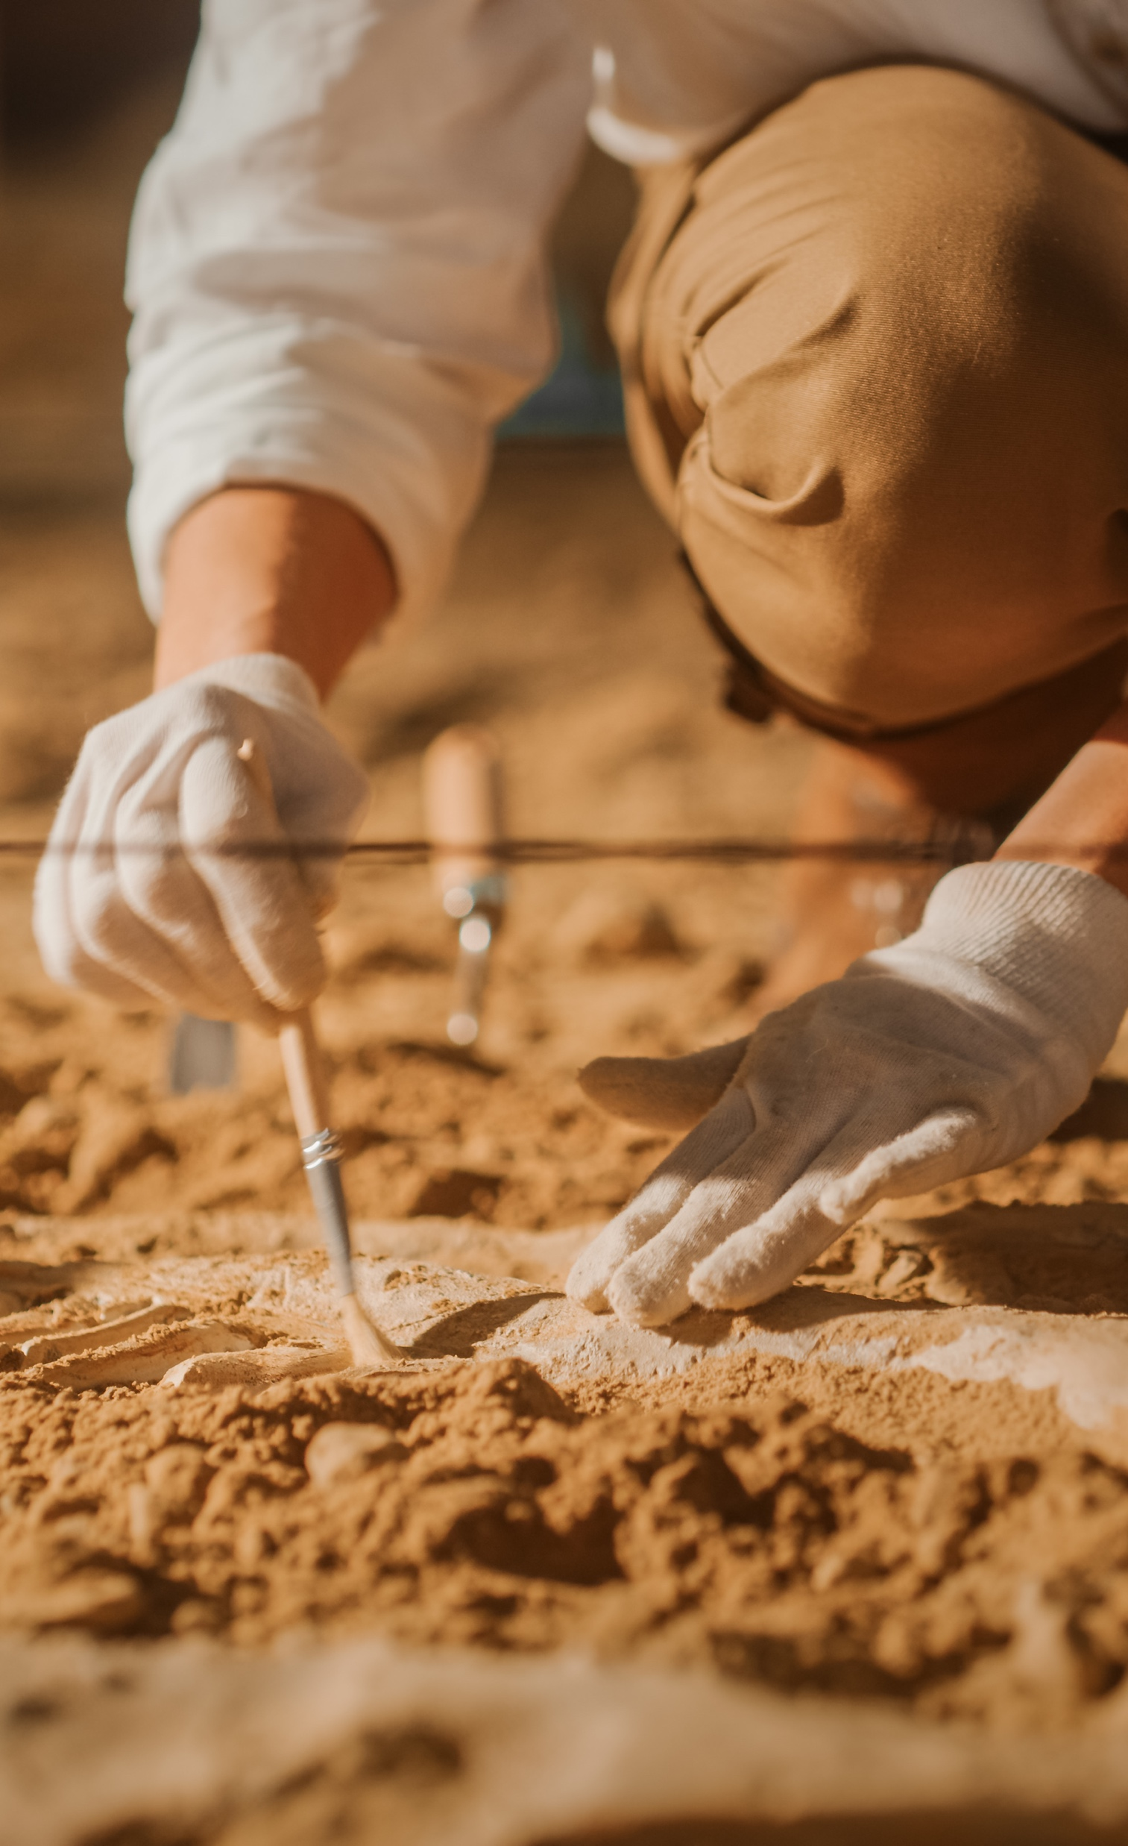
SPONSORSHIP
OPPORTUNITIES
Research topic and academic host / unrestricted selection of collaborative partner in Germany
From postdocs via experienced researchers to world leaders: research fellowships and research awards for every career situation

Slide 13
MAJOR SPONSORSHIP PROGRAMMES AT A GLANCE
 | Researchers from abroad | Researchers from Germany
Postdoctoral researchers (up to 4 years after doctorate) | Humboldt Research Fellowship Georg Forster Research Fellowship | Feodor Lynen Research Fellowship
Experienced researchers (up to 12 years after doctorate) | Humboldt Research Fellowship Georg Forster Research Fellowship | Feodor Lynen Research Fellowship
(up to 15 years after doctorate) | Max Planck-Humboldt Research Award
(up to 18 years after doctorate) | Friedrich Wilhelm Bessel Research Award
Internationally recognised researchers | Humboldt Research Award Georg Forster Research Award Alexander von Humboldt Professorship (for Artificial Intelligence)

Slide 14
THANK YOU
Do you have any questions?
Speaker
Function
info@avh.de
www.humboldt-foundation.de

